Slide 1

Sleep Paralyzed
Fadilla Zennifa
Graduate School System Life Science
Kyushu University

Slide 2
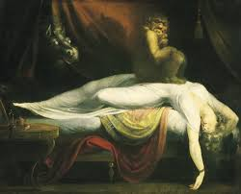
SLEEP PARALYZE IS…
Involves temporary immobility at sleep, while individual are awake and aware of their surrounding
The Seahorse,the Almond,and The Night-mare: Elaborative Encoding During Sleep Paralysis Hallucinations?
Todd A.Girard

Slide 3
Fear and hallucinatory experiences are frequently associated

Slide 4
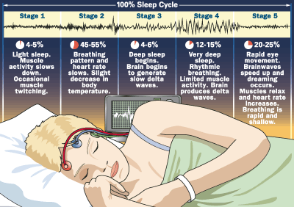
Notes:
Dreaming in 5th stage

Slide 5
Why it happen?
1 cycle is 90 minutes
REM
NREM
Take 75% sleep time
Notes:
During sleep, your body alternates between REM (rapid eye movement) and NREM (non-rapid eye movement) sleep. One cycle of REM and NREM sleep lasts about 90 minutes. NREM sleep occurs first and takes up to 75% of your overall sleep time. During NREM sleep, your body relaxes and restores itself. At the end of NREM, your sleep shifts to REM. Your eyes move quickly and dreams occur, but the rest of your body remains very relaxed. Your muscles are "turned off" during REM sleep. If you become aware before the REM cycle has finished, you may notice that you cannot move or speak

Slide 6
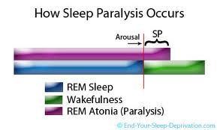

Slide 7
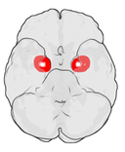
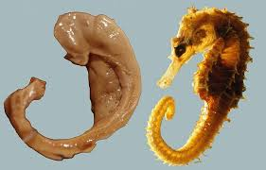
Hippocampus
( The Sea Horse)
Amygdala (almond)
Llewellyn’s proposal that rapid eye movement (REM) dreaming elaborative encoding mediated by the hipocampus offers an interesting perspective for understanding hallucination in sleep paralysis
Hallucination happened because REM-induced activation of amygdala
Notes:
It would be interesting to code and compare Sleep paralysis narratives with reports of dreams and waking episodic memories.
Amigdala dipercayai merupakan bagian otak yang berperan dalam melakukan pengolahan daningatan terhadap reaksi emosi.
Hipokampus merupakan bagian dari sistem limbik dan berperan pada kegiatan mengingat (memori) dan navigasi ruangan.

Slide 8
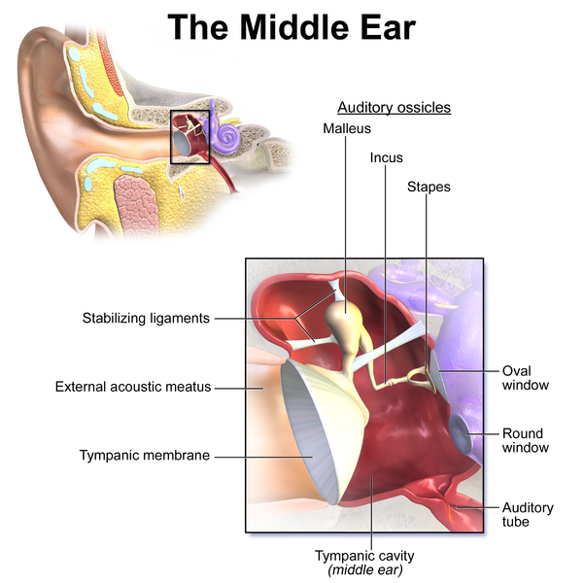
Notes:
Stapes = smallest muscle
The stapedius muscle, the smallest skeletal muscle in the body, connects to the stapes and is controlled by the facial nerve
Ear is vestibullar system

Slide 9
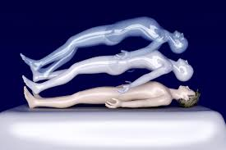
Processes underlying elaborative encoding might function not only to strengthen episodic memory, but also to create novel imaginative scenarios for adaptive activation and honing of neural systems, such as those involved in threat detection

Slide 10

Have a Nice Dream

Slide 11
sources
http://www.nhs.uk/conditions/sleep-paralysis/Pages/Introduction.aspx
For video https://www.youtube.com/watch?v=bykP9v1wiGo

